Slide 1
Newton’s Divided Difference Polynomial Method of Interpolation
by Dr. Md. Rajibul Islam
CSE, UAP
‹#›

Slide 2
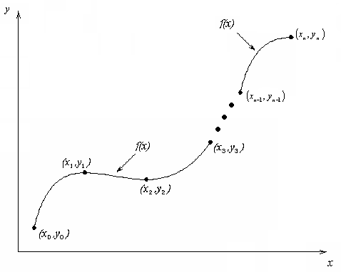
What is Interpolation ?
Given (x₀,y₀), (x₁,y₁), …… (x_{n},y_{n}), find the value of ‘y’ at a value of ‘x’ that is not given.
‹#›

Slide 3
Interpolants
Polynomials are the most common choice of interpolants because they are easy to:
Evaluate
Differentiate, and
Integrate.
‹#›

Slide 4
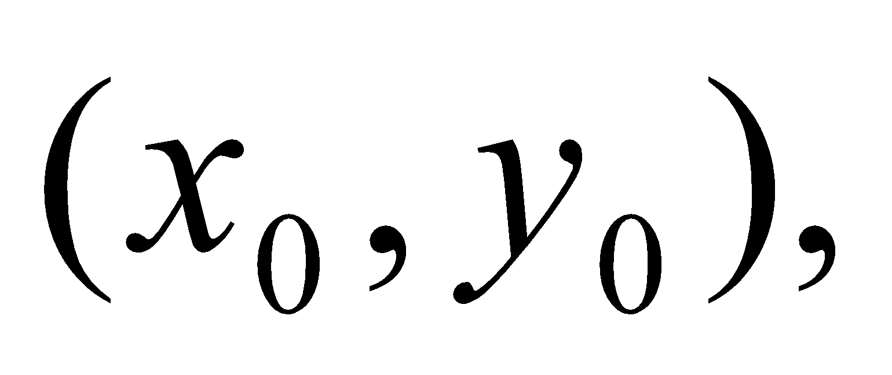
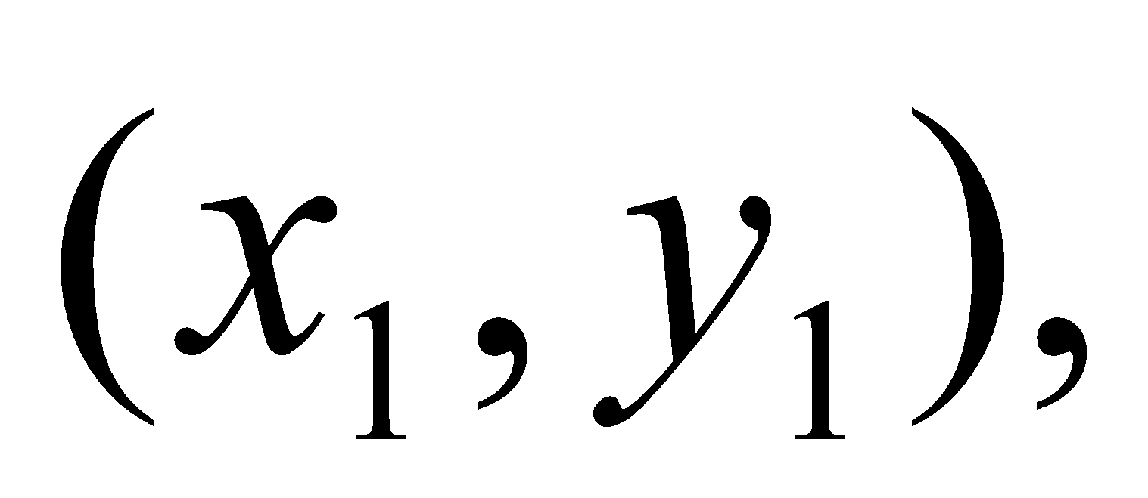
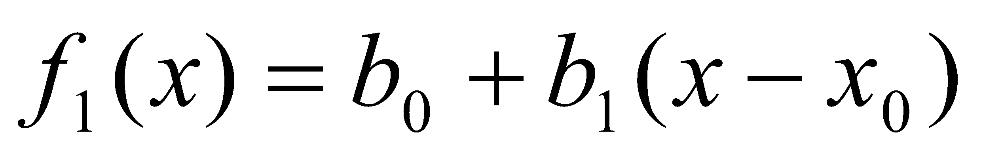
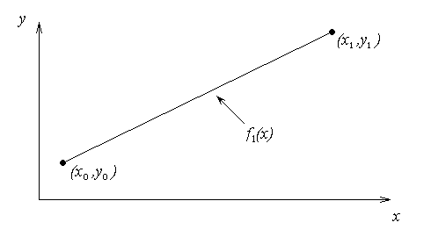
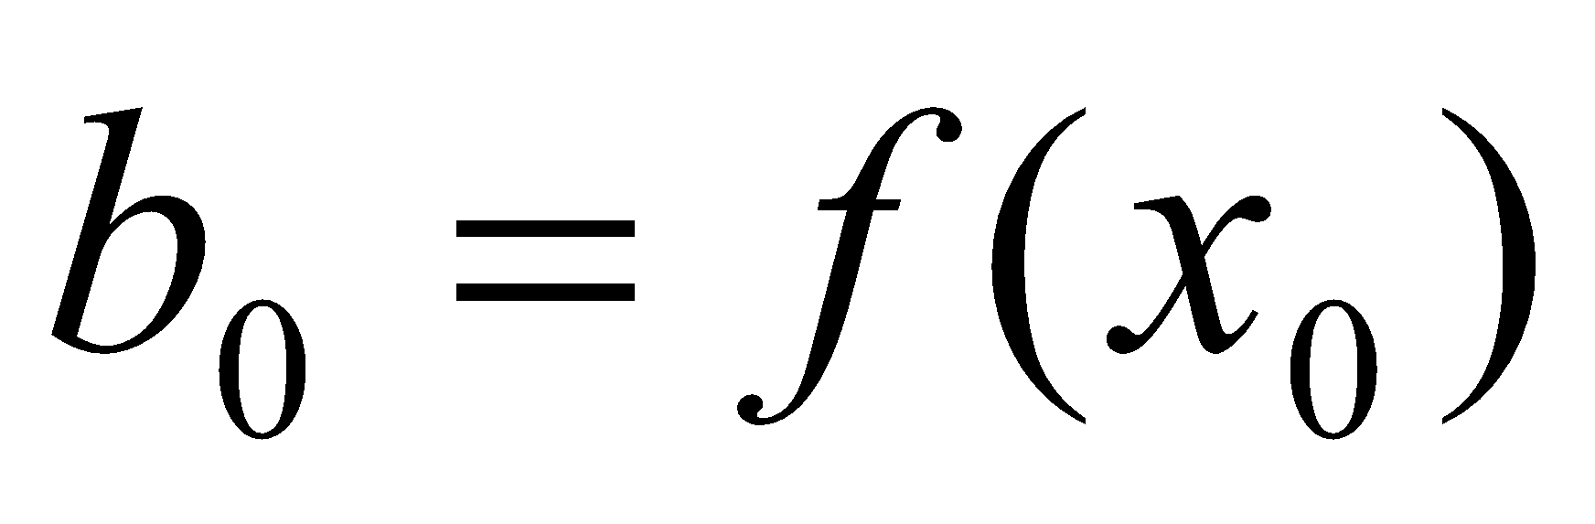
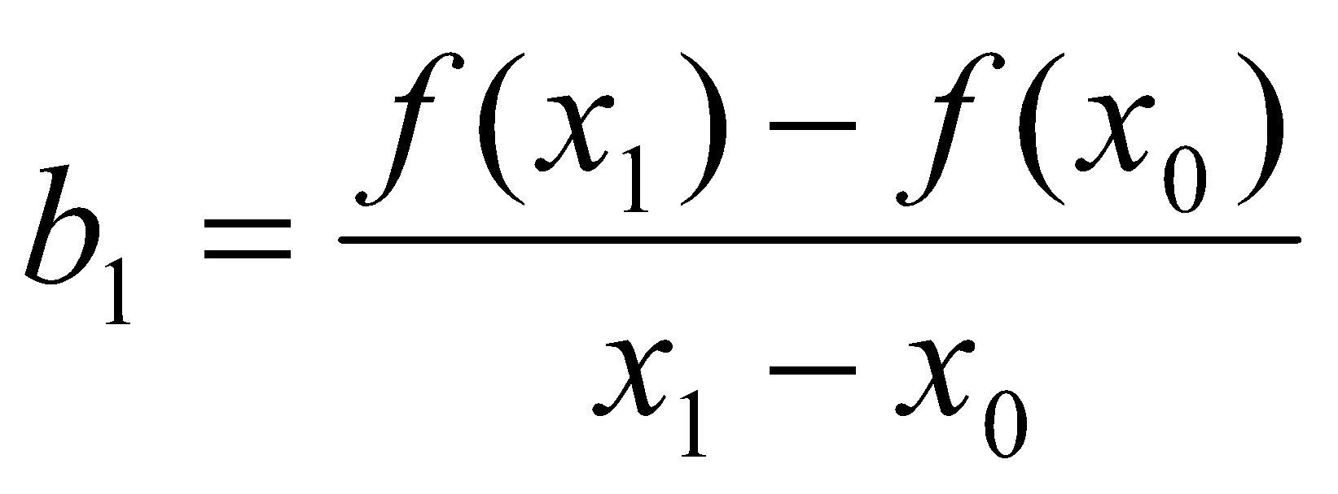
Newton’s Divided Difference Method
Linear interpolation: Given pass a linear interpolant through the data
where
‹#›

Slide 5
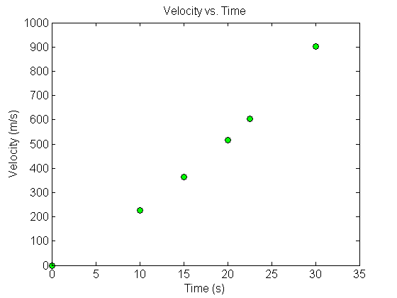
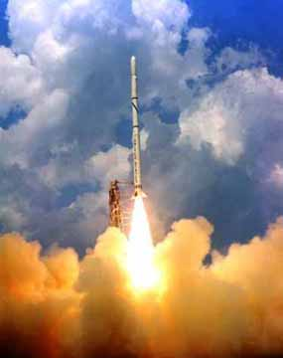
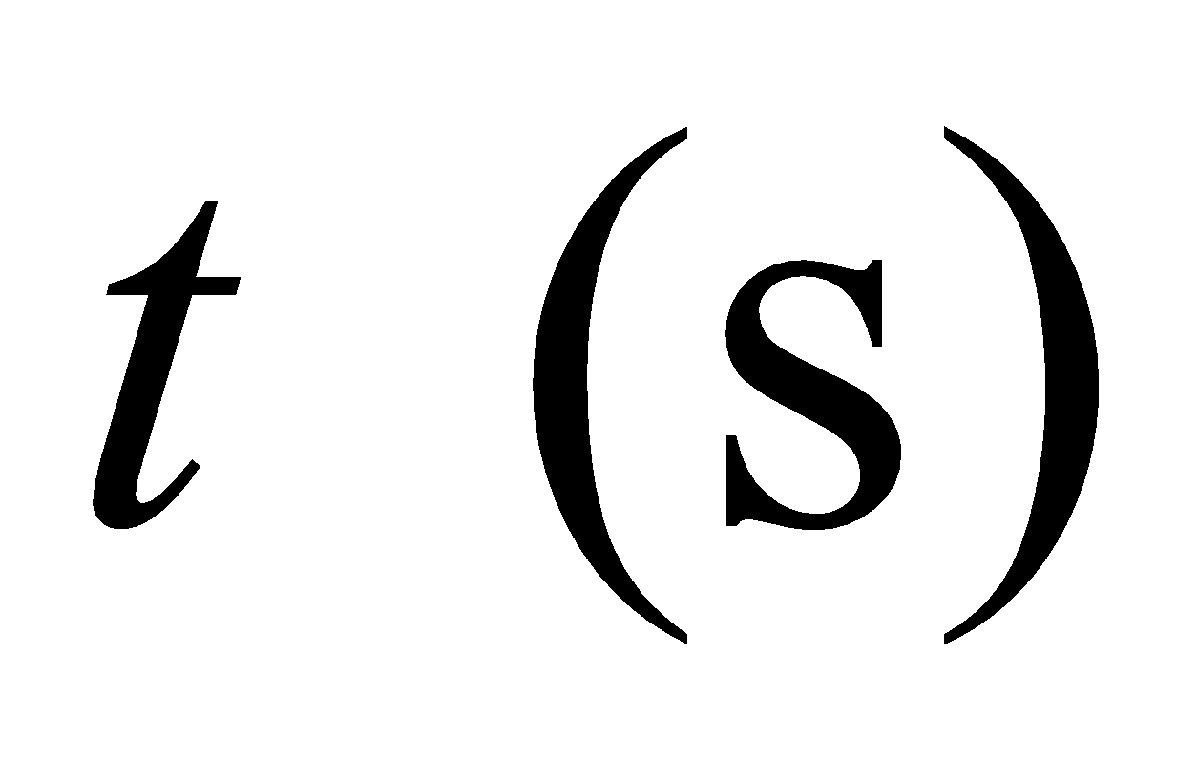
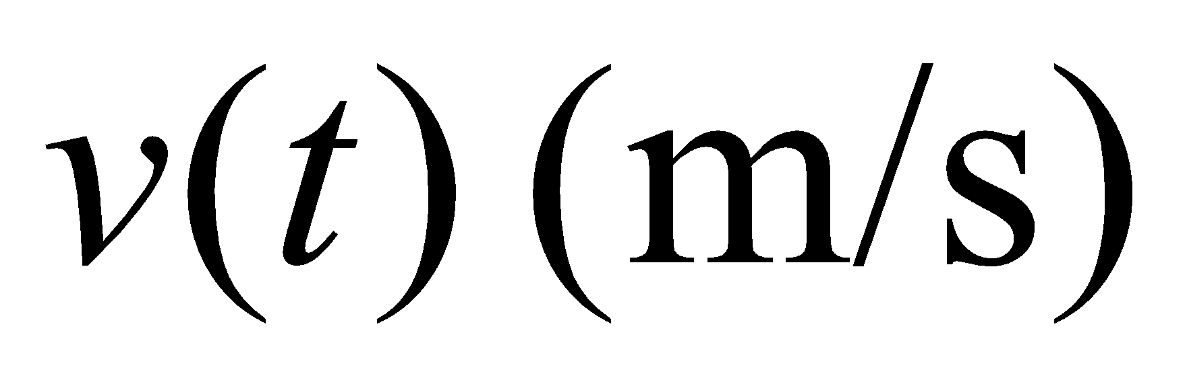
Example
The upward velocity of a rocket is given as a function of time in Table 1. Find the velocity at t=16 seconds using the Newton Divided Difference method for linear interpolation.
Table. Velocity as a
function of time
0 | 0
10 | 227.04
15 | 362.78
20 | 517.35
22.5 | 602.97
30 | 901.67
Figure. Velocity vs. time data
for the rocket example
‹#›

Slide 6
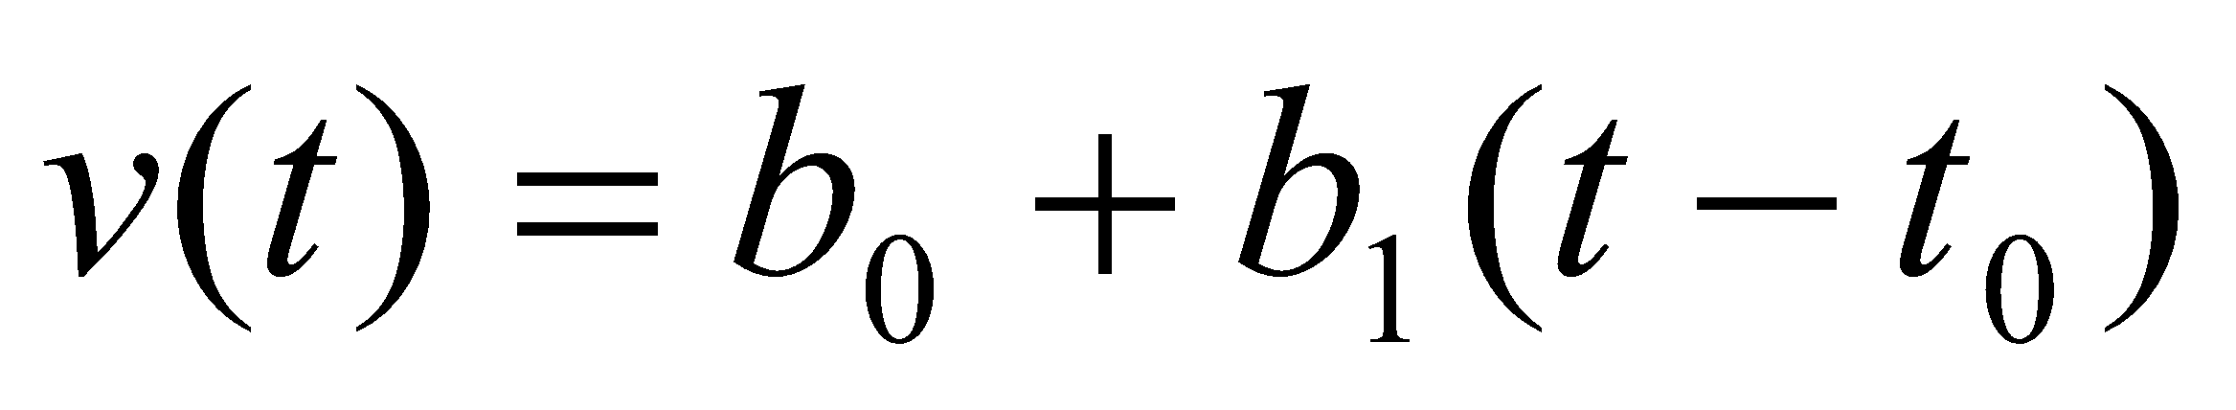
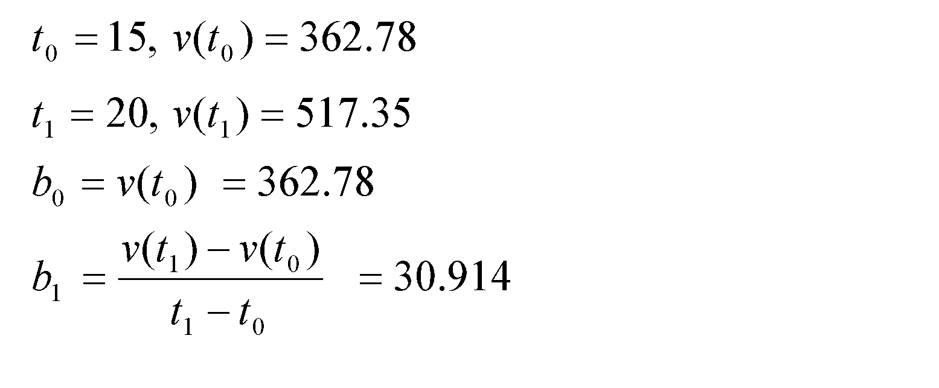
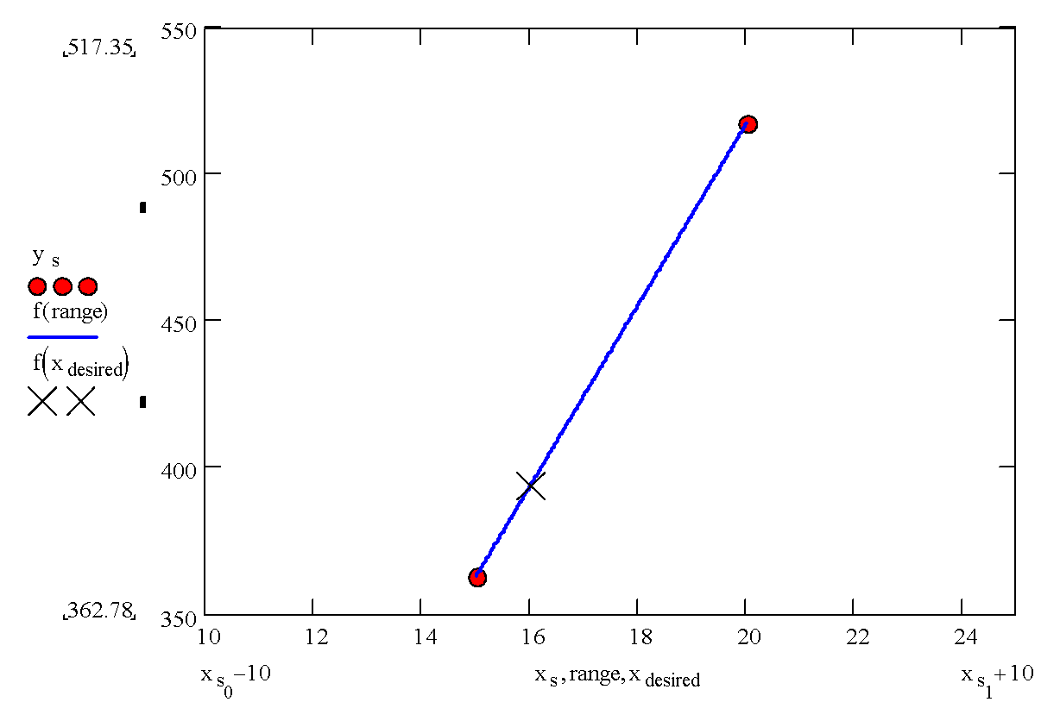
Linear Interpolation
‹#›

Slide 7
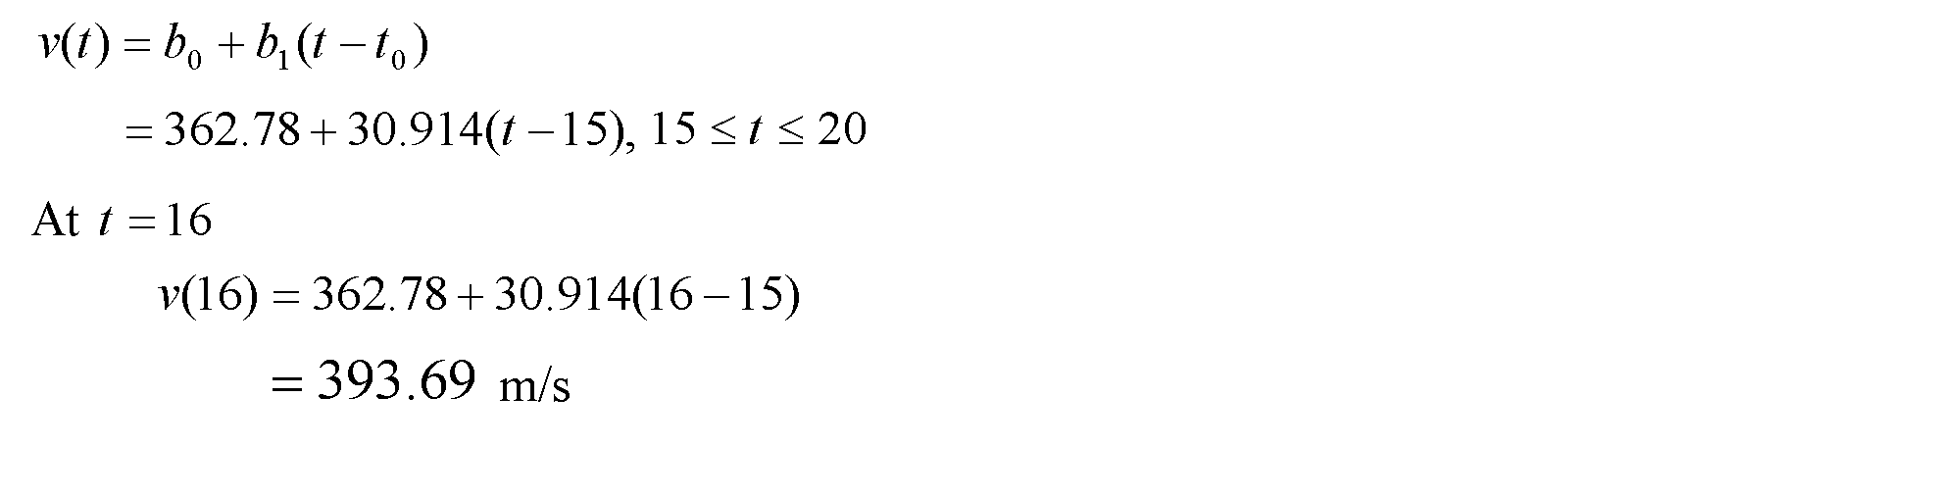
Linear Interpolation (contd)
‹#›

Slide 8
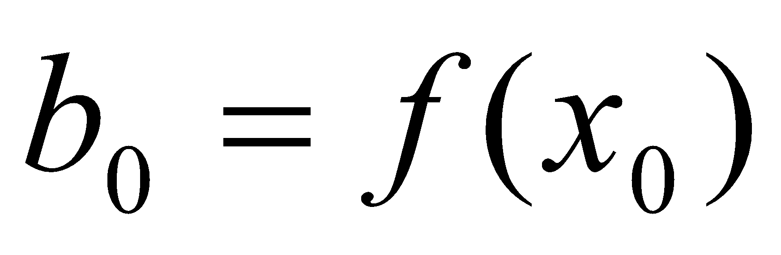
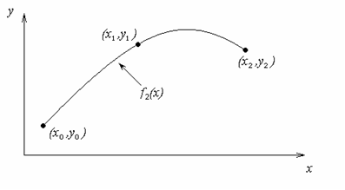
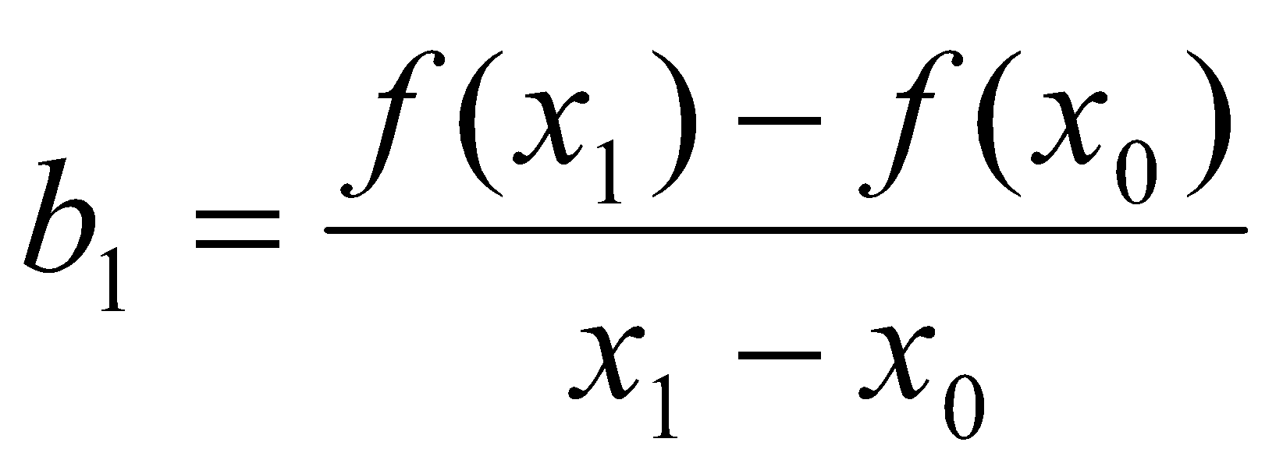
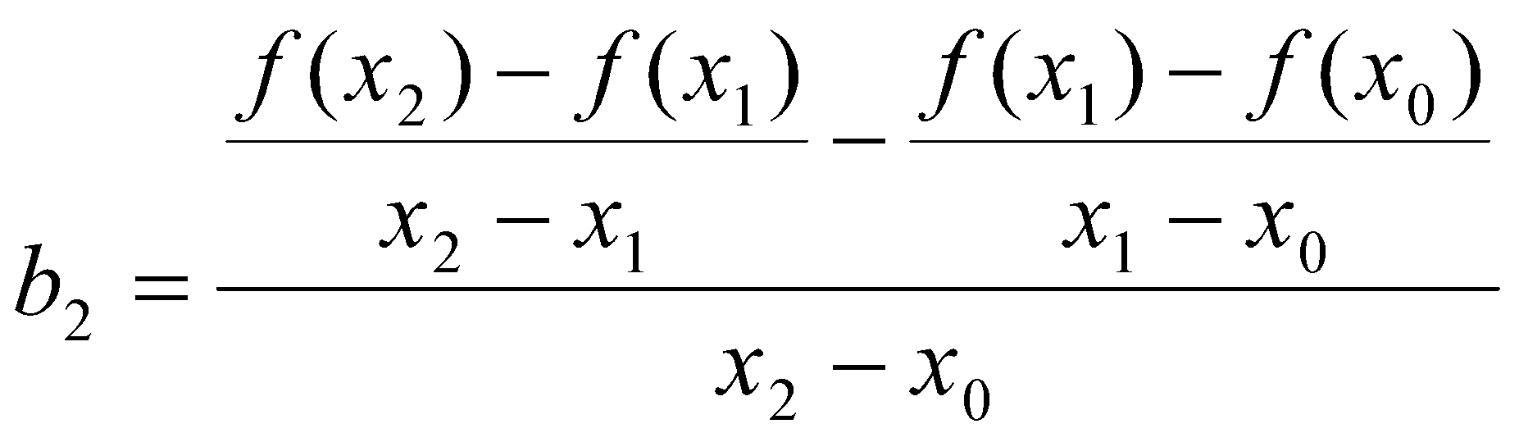
Quadratic Interpolation
‹#›

Slide 9
Example
The upward velocity of a rocket is given as a function of time in Table 1. Find the velocity at t=16 seconds using the Newton Divided Difference method for quadratic interpolation.
Table. Velocity as a
function of time
0 | 0
10 | 227.04
15 | 362.78
20 | 517.35
22.5 | 602.97
30 | 901.67
Figure. Velocity vs. time data
for the rocket example
‹#›

Slide 10

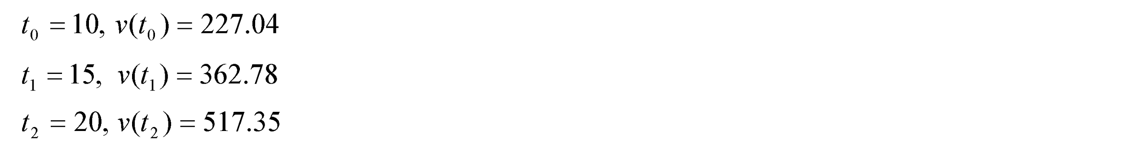
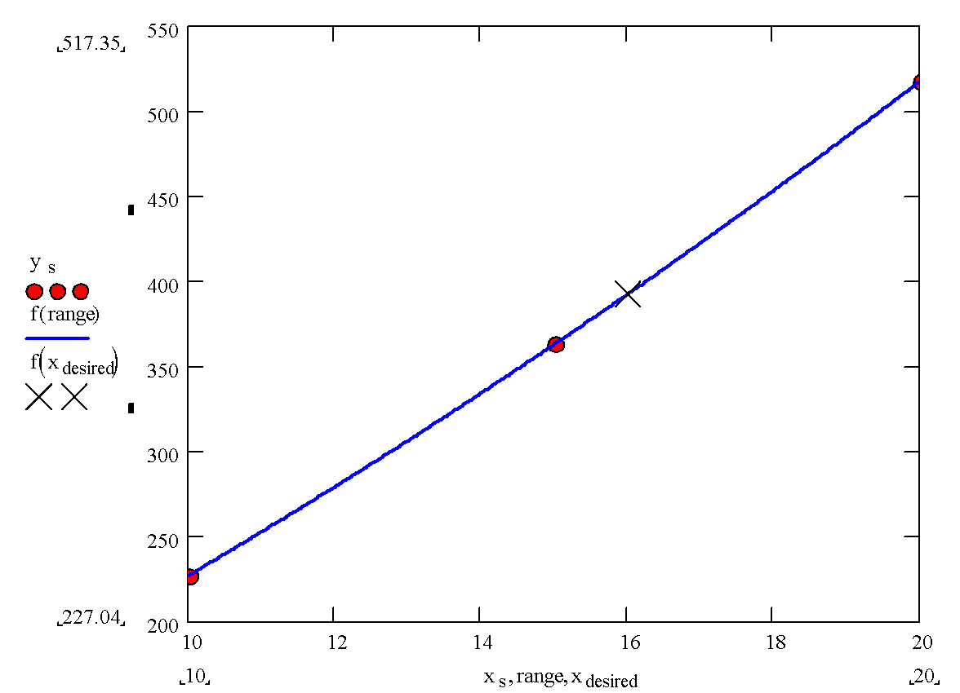
Quadratic Interpolation (contd)
‹#›

Slide 11
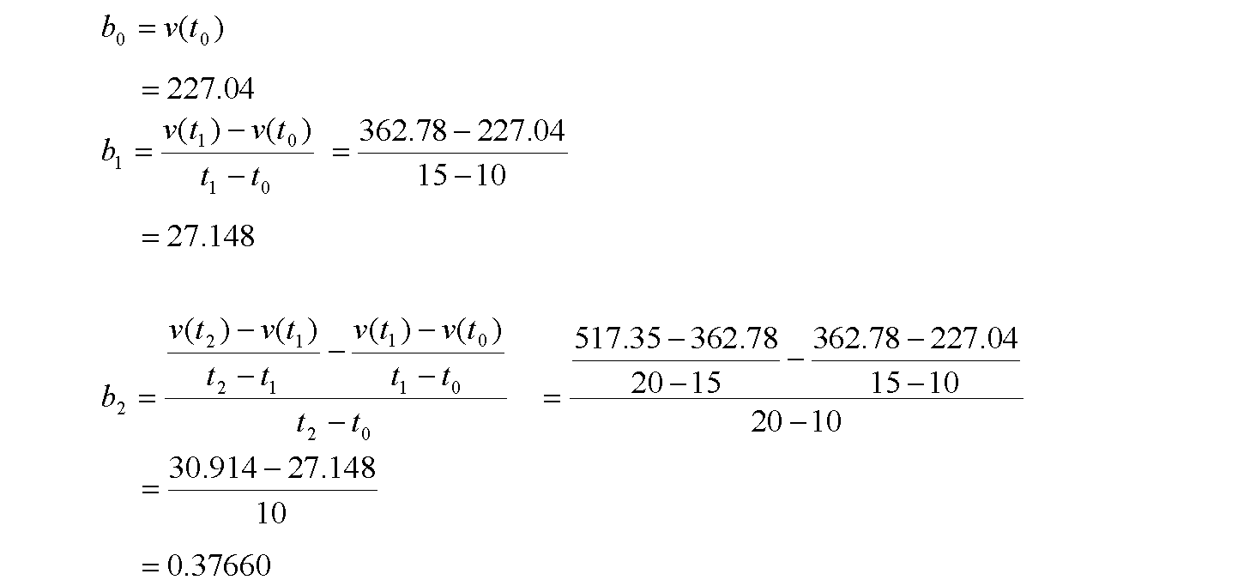
Quadratic Interpolation (contd)
‹#›

Slide 12
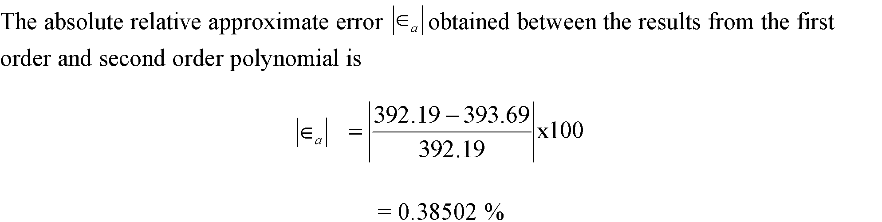
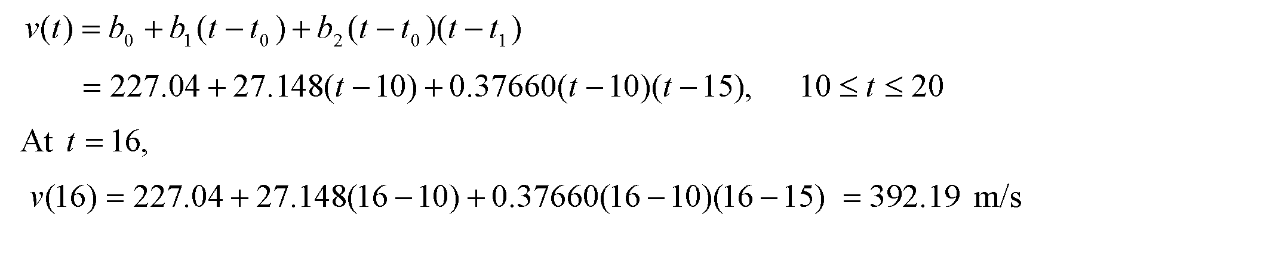
Quadratic Interpolation (contd)
‹#›

Slide 13
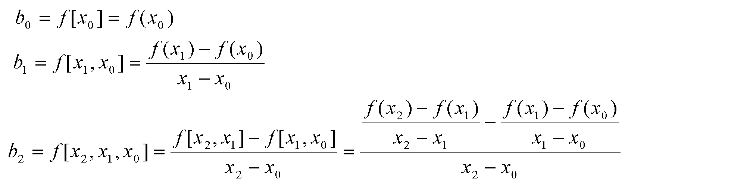
General Form
where
Rewriting
‹#›

Slide 14
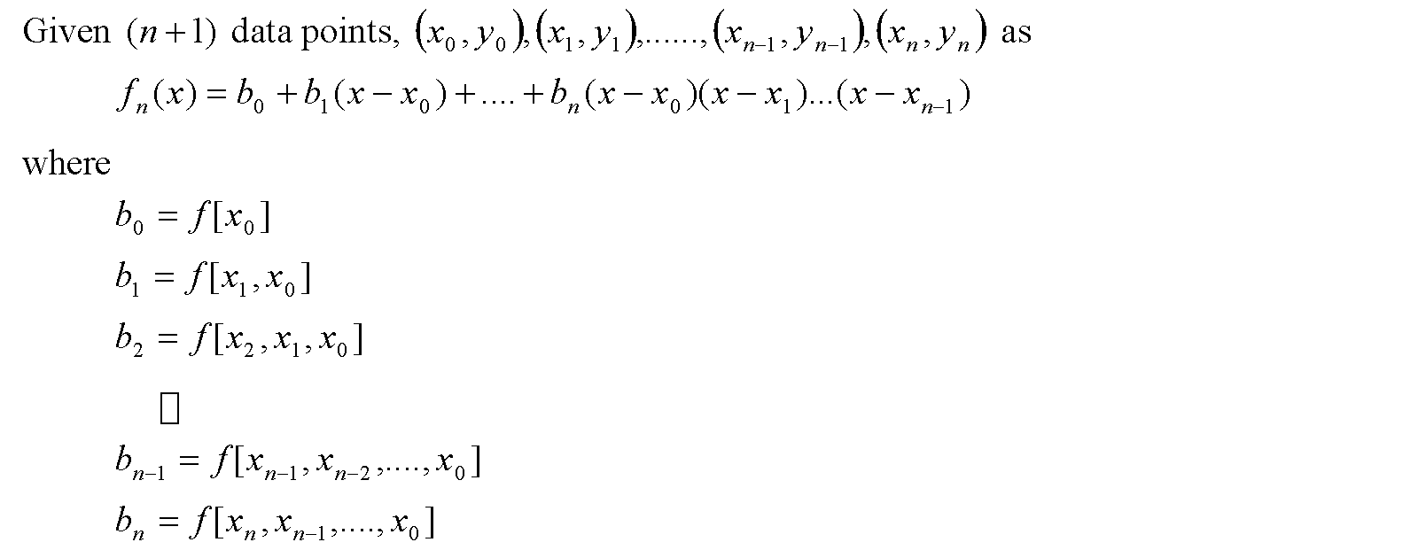
General Form
‹#›

Slide 15
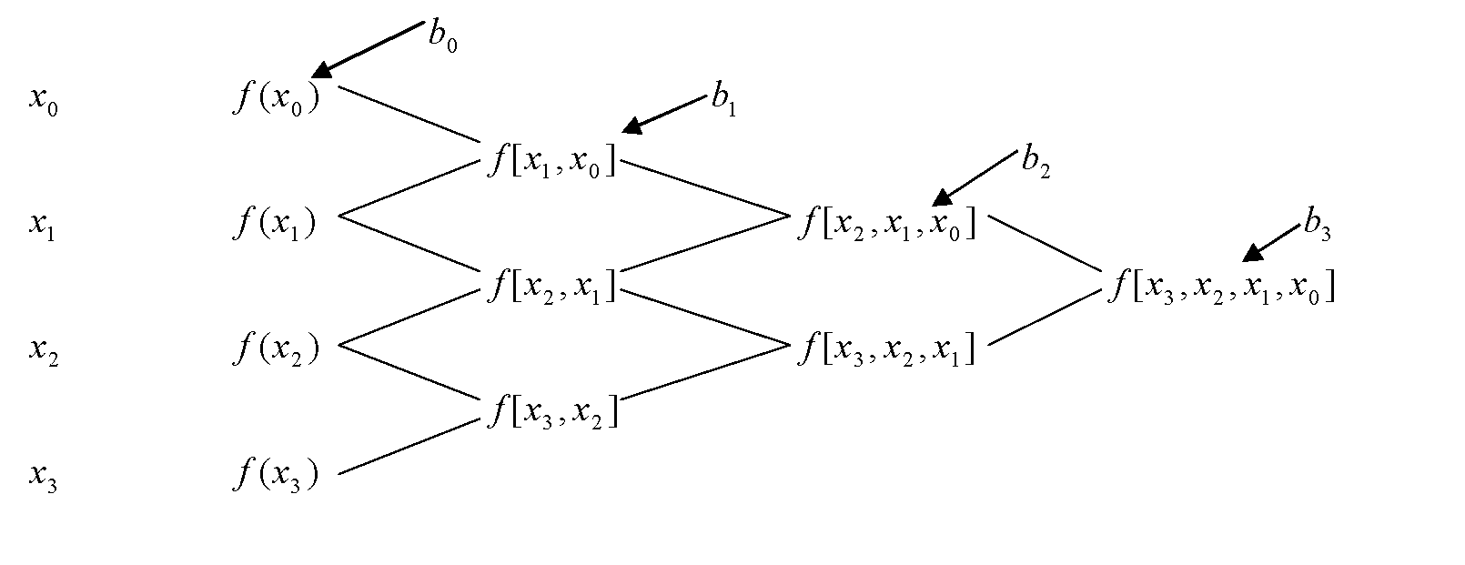
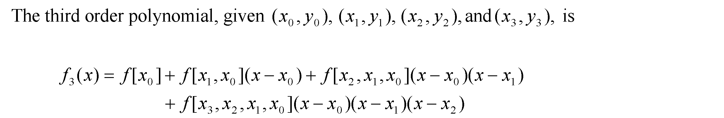
General form
‹#›

Slide 16
Example
The upward velocity of a rocket is given as a function of time in Table 1. Find the velocity at t=16 seconds using the Newton Divided Difference method for cubic interpolation.
Table. Velocity as a
function of time
0 | 0
10 | 227.04
15 | 362.78
20 | 517.35
22.5 | 602.97
30 | 901.67
Figure. Velocity vs. time data
for the rocket example
‹#›

Slide 17
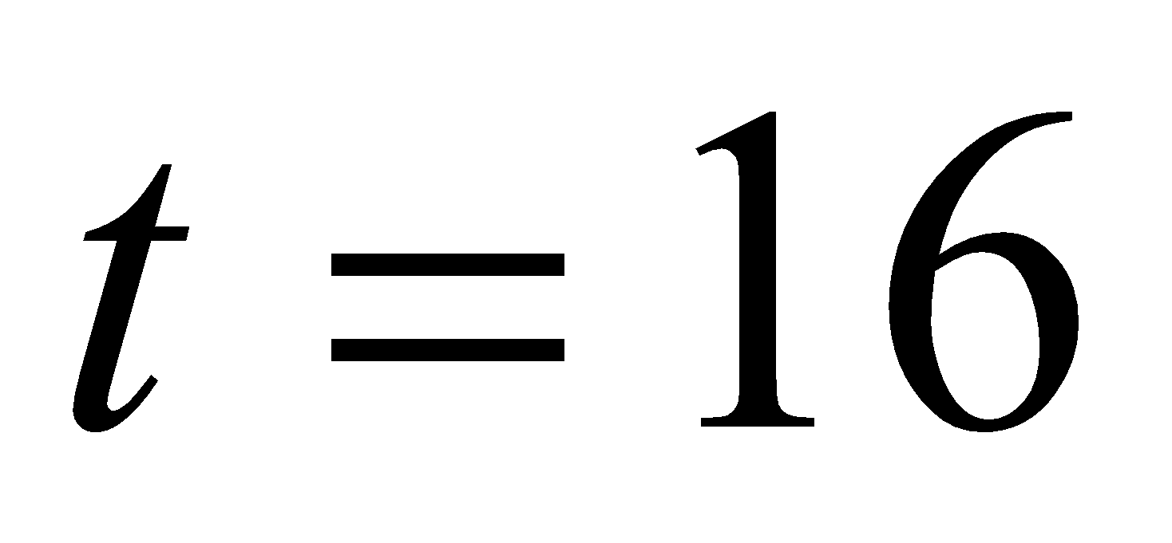
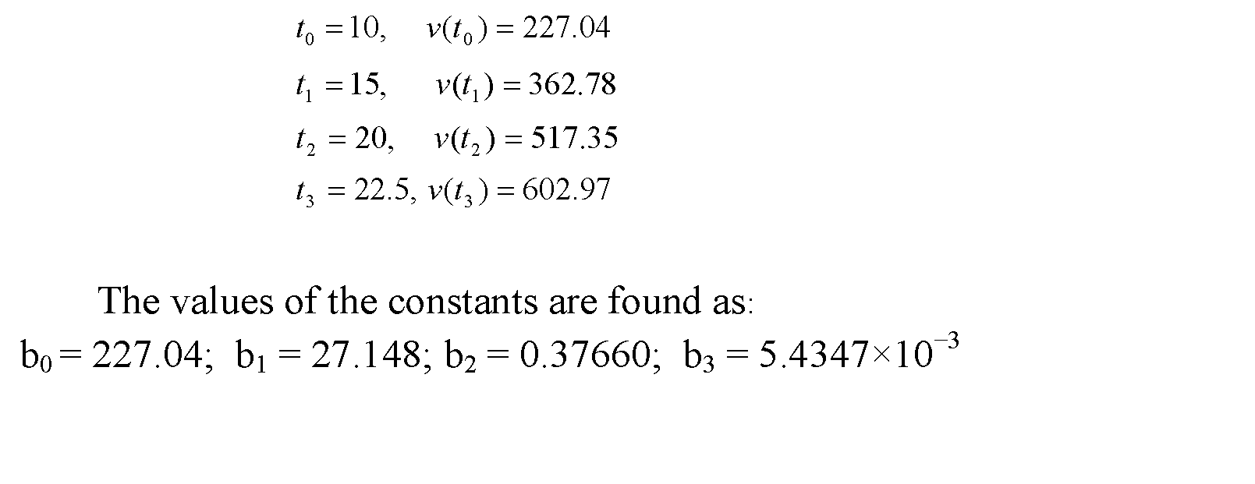
Example
The velocity profile is chosen as
we need to choose four data points that are closest to
‹#›

Slide 18
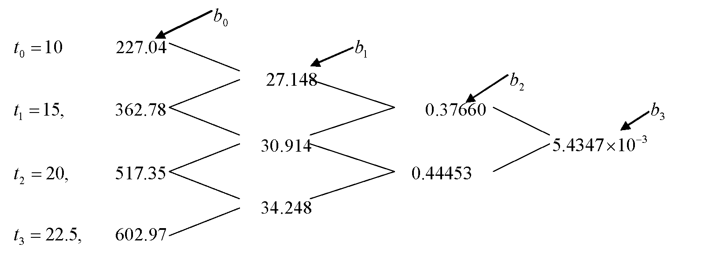
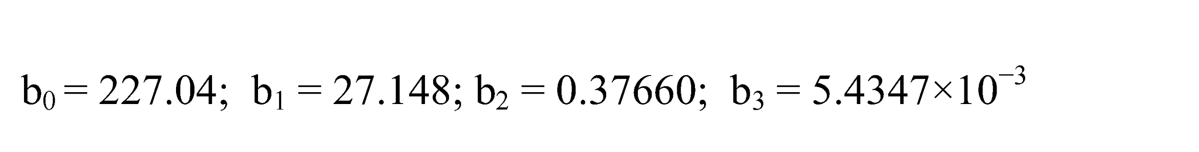
Example
‹#›

Slide 19
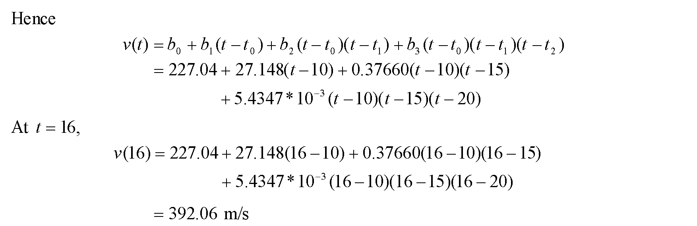
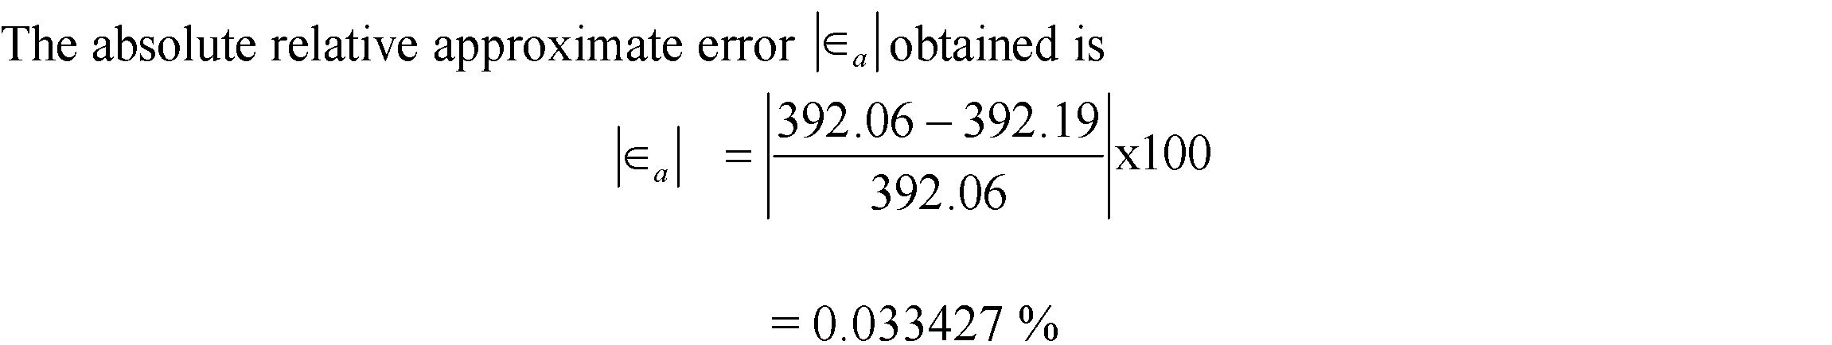
Example
‹#›

Slide 20
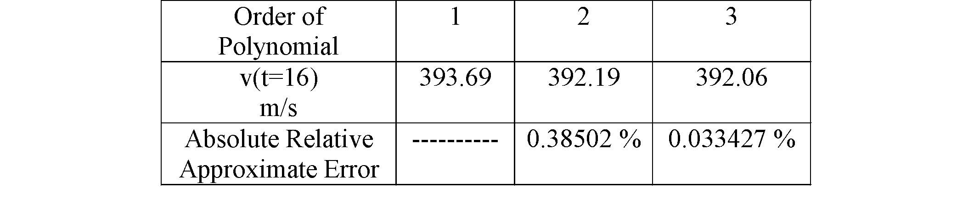
Comparison Table
‹#›

Slide 21
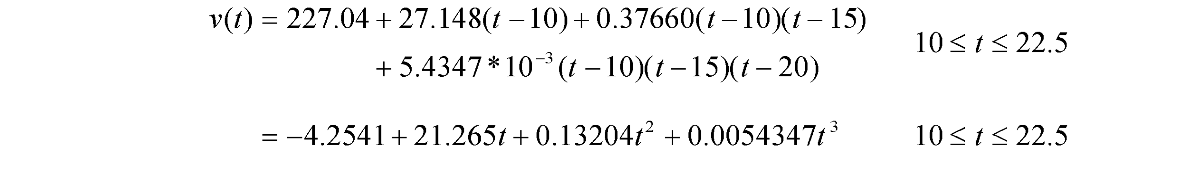
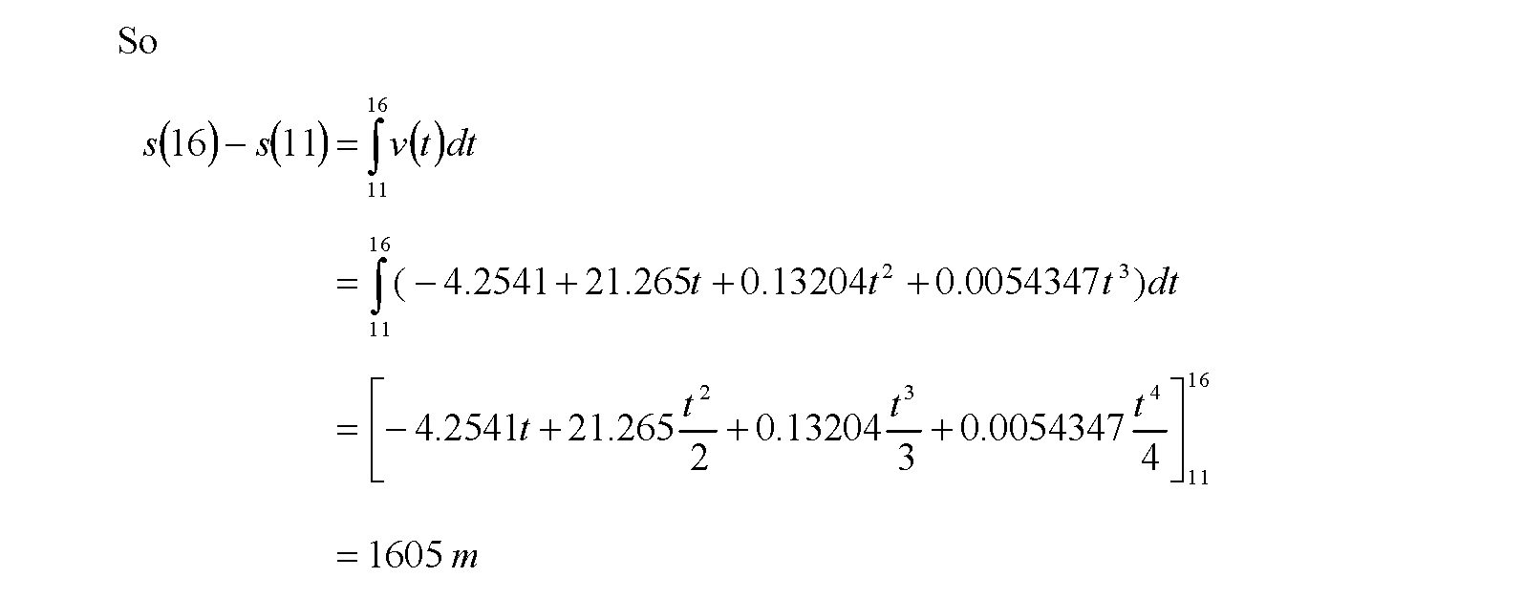
Distance from Velocity Profile
Find the distance covered by the rocket from t=11s to
t=16s ?
‹#›

Slide 22
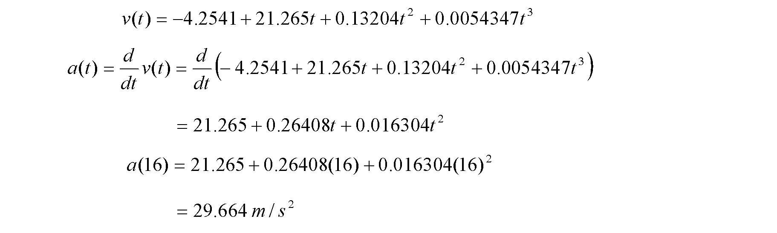
Acceleration from Velocity Profile
Find the acceleration of the rocket at t=16s given that
‹#›

Slide 23
THE END
Notes:
‹#›

